Slide 1

Topic Modeling on Amazon Review Data Set
Project of Big Data Analytics
By,
Sakshi Jaiswal,
Saloni Mishra,
Megha Thummar

Slide 2
MACHINE LEARNING
UNSUPERVISED
KMEANS
LDA
HEIRARICAL CLUSTERING
DIMENTIONALITY REDUCTION
LDA
SUPERVISED
LOGISTIC
SVM
DECISION TREE
(CATEGORICAL )
LINEAR REGRESSION
(QUANTITATIVE)
CLASSIFICATION
REGRESSION
CLUSTERING

Slide 3
CLUSTERING
HARD CLUSTERING
HIERARICHICAL CLUSTERING
SOFT CLUSTERING

Slide 4
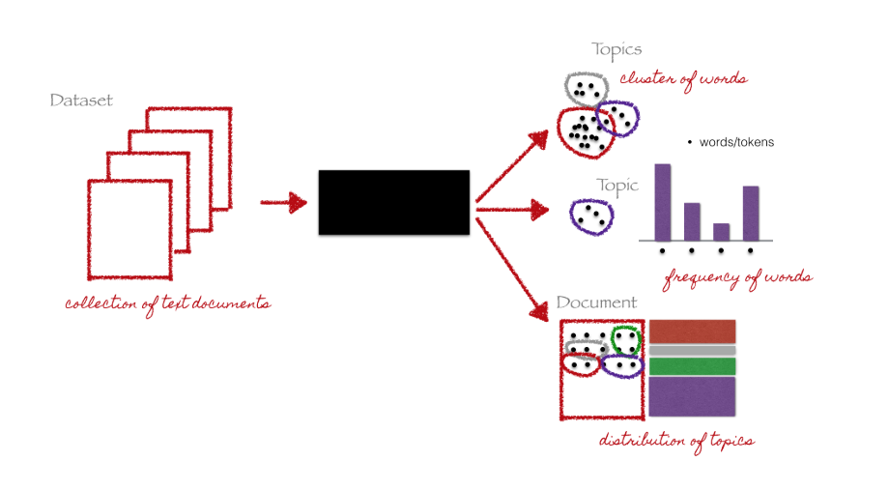
TOPIC MODELING
Topic modeling is a branch of unsupervised natural language processing which is used to represent a text document with the help of several topics, that can best explain the underlying information in a particular document. This can be thought in terms of clustering, but with a difference. Now, instead of numerical features, we have a collection of words that we want to group together in such a way that each group represents a topic in a document.
Credit: Christine Doig

Slide 5






FLOW CHART OF WORKING PLAN
(RAW AMAZON DATASET (34GB, zipped)
EXPLORATORY DATA ANALYSIS
(EDA)
DATA PROCESSING
TESTING
VALIDATION
MACHINE LEARNING

Slide 6
AMAZON DATASET (Magazine Subscription)
VARIABLES:
reviewerID - ID of the reviewer
asin - ID of the product
reviewerName - name of the reviewer
vote - helpful votes of the review
style - a disctionary of the product metadata
reviewText - text of the review
overall - rating of the product
summary - summary of the review
unixReviewTime - time of the review (unix time)
reviewTime - time of the review (raw)
Image
verified

Slide 7
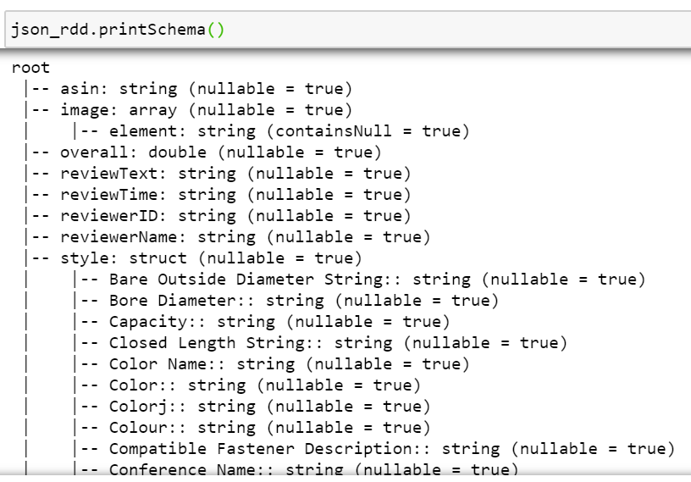

Slide 8
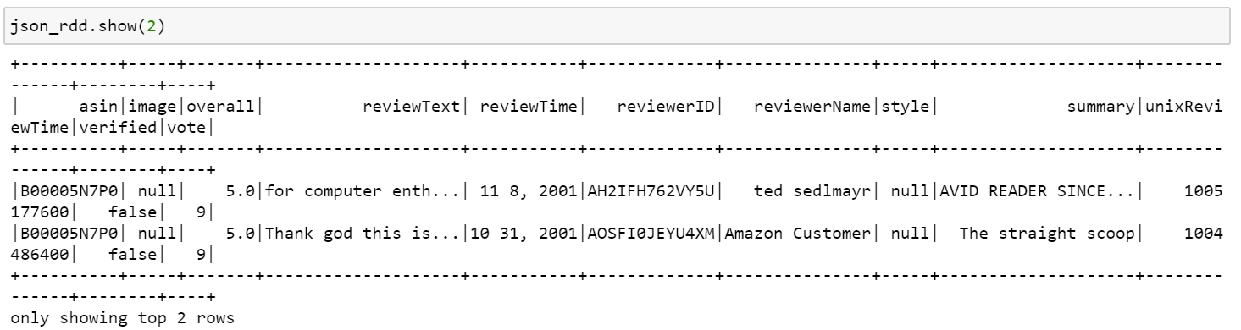
Screenshot of Preview Data frame

Slide 9
EDA
Total number of words
: 3920235
Total number of characters
:21871568

Slide 10
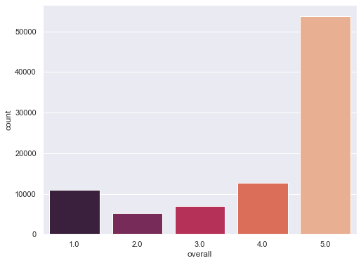
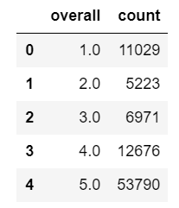
FREQUENCY DISTRIBUTION AND GRAPHICAL PRESENTATION OF OVERALL VARIABLE

Slide 11
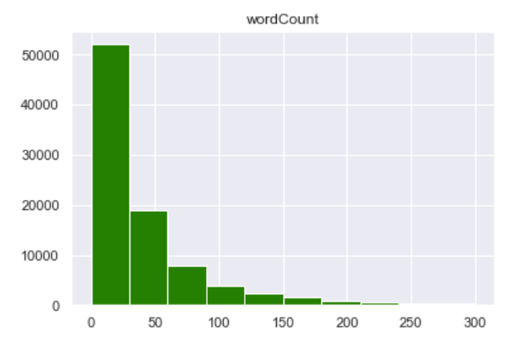
Graphical Presentation of Number of Words per ReviewText

Slide 12
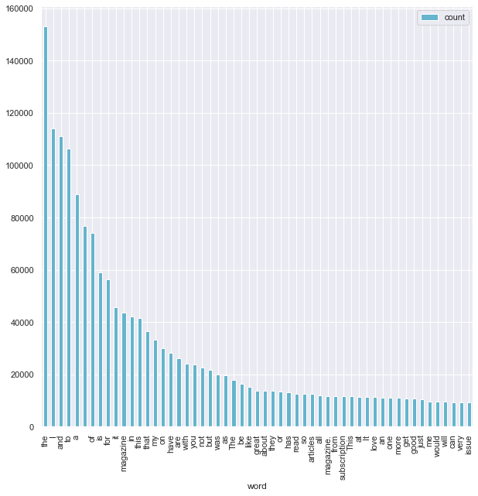
Graphical Presentation of Most Frequent Words

Slide 13
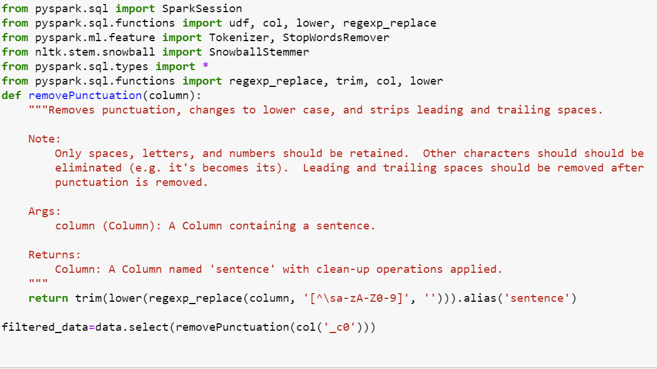
Removing Punctuation

Slide 14
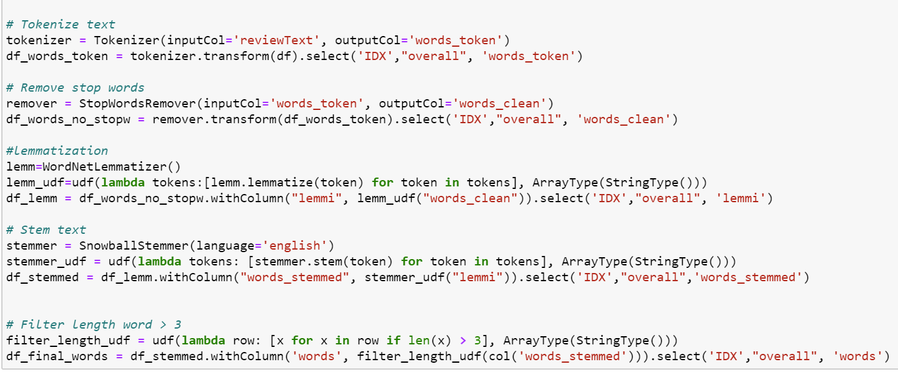
Screenshot of Programming of Data Processing

Slide 15
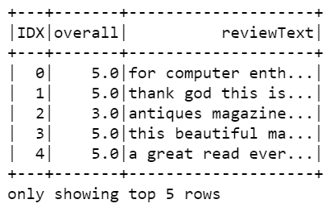
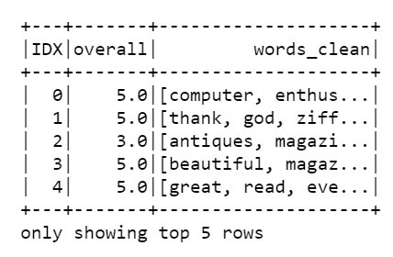
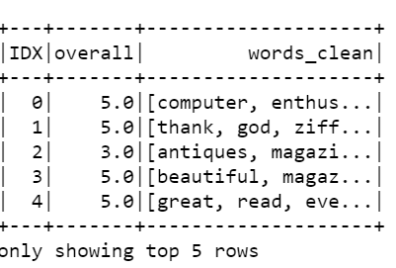
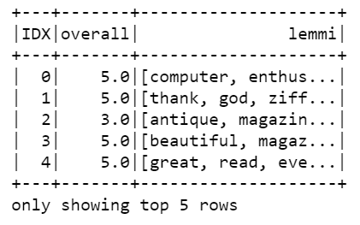
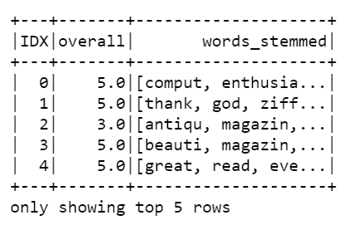
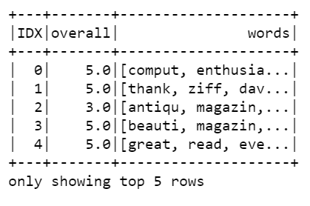
DATA PROCESSING SCREENSHOTS

Slide 16
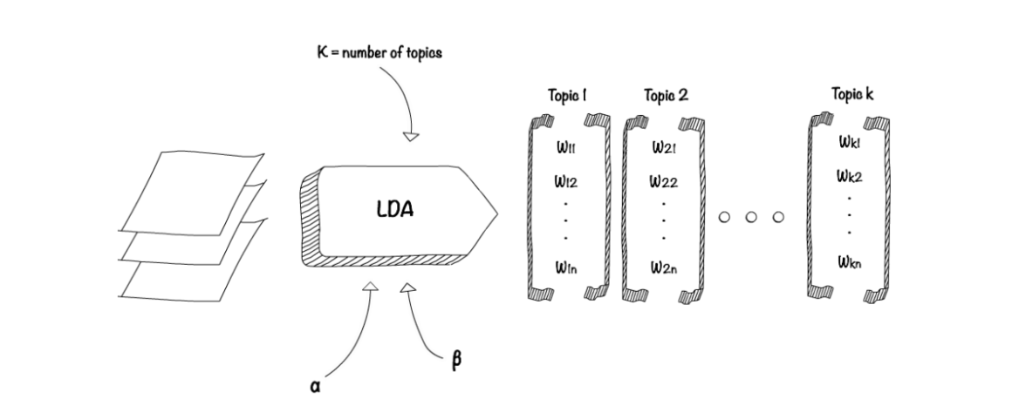
What is LDA?
LDA is an unsupervised machine-learning model that takes documents as input and finds topics as output. The model also says in what percentage each document talks about each topic. A topic is represented as a weighted list of words. ... the number of topics per document

Slide 17
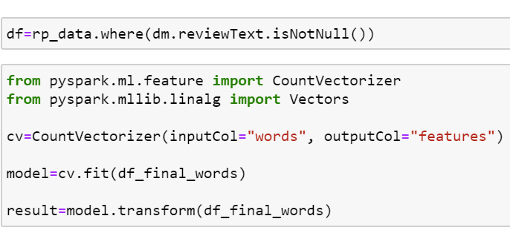
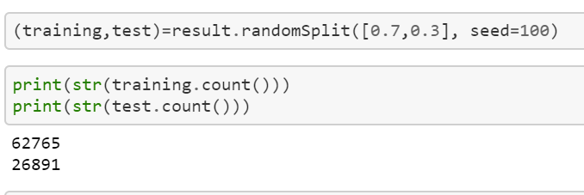
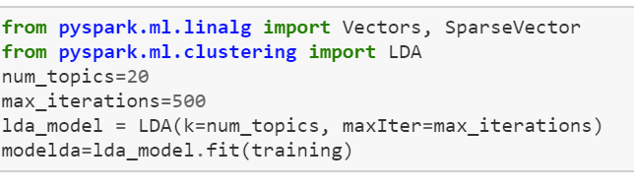
Screen Shots

Slide 18
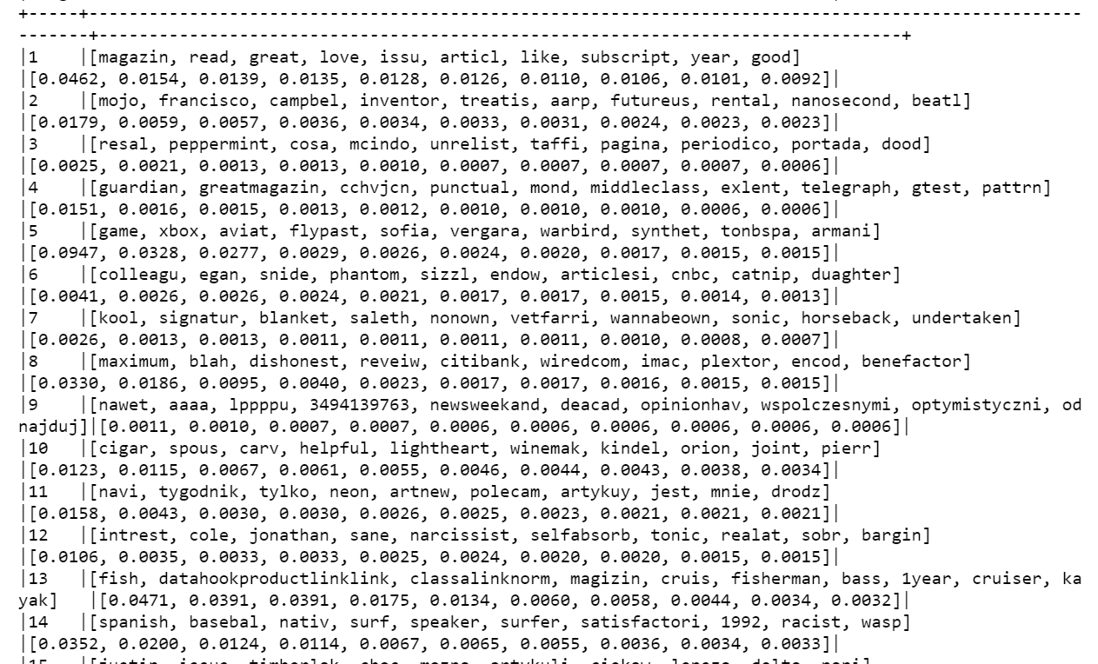
Top topics along with their weights

Slide 19
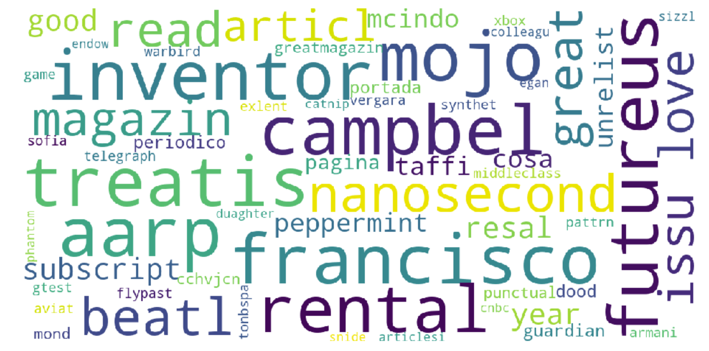
WORD CLOUD OF TOP SIX TOPICS

Slide 20
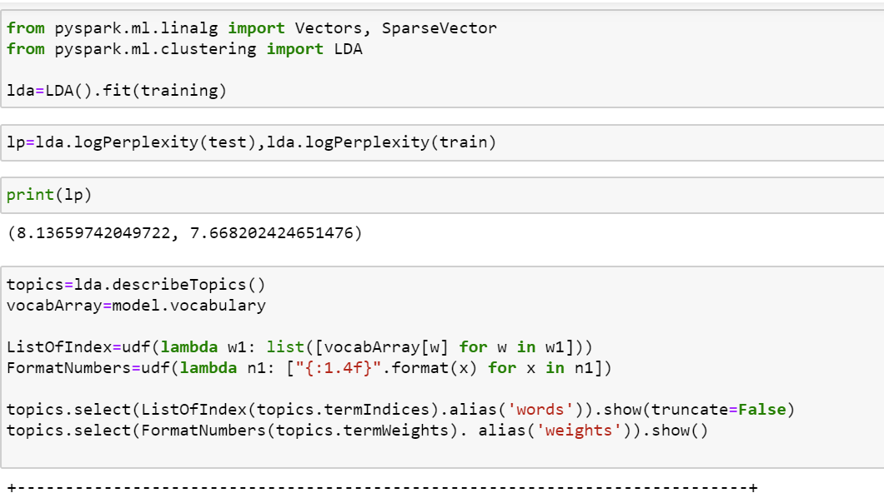
LATENT DIRICHLET ALLOCATION

Slide 21
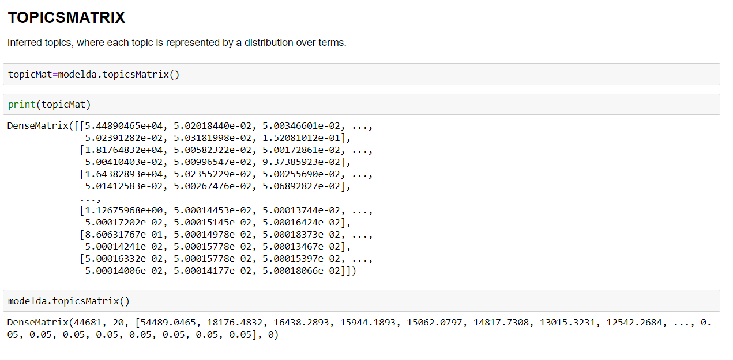
TOPIC DISTRIBUTION

Slide 22
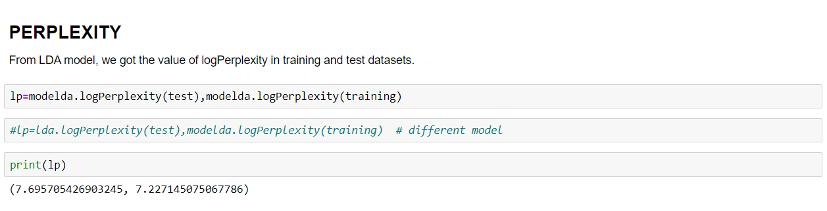
VALIDATION

Slide 23
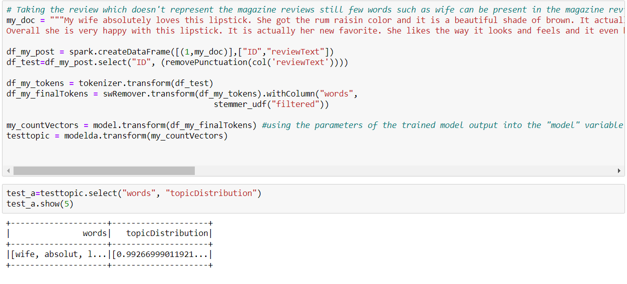
TESTING

Slide 24
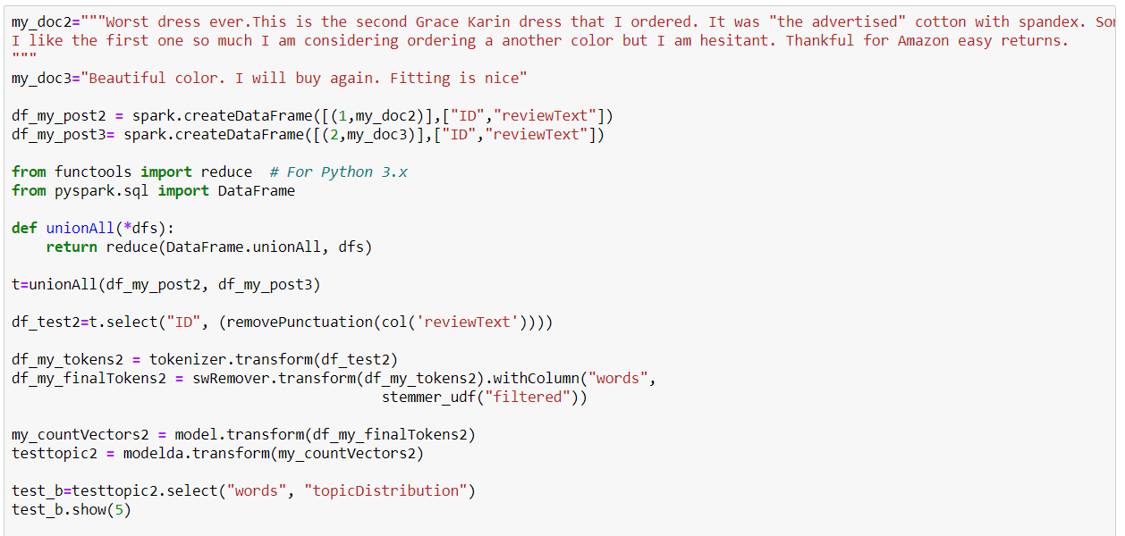
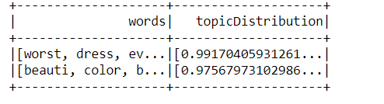

Slide 25
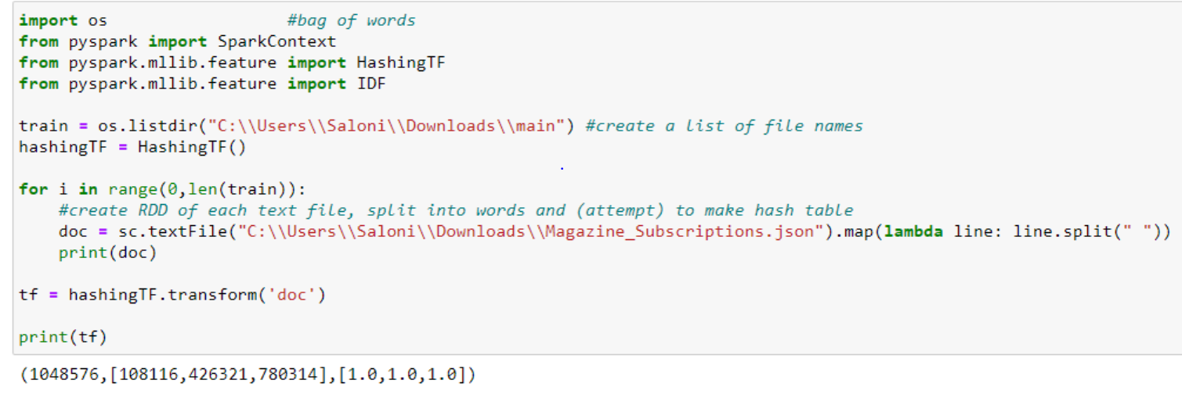
HASHING TF

Slide 26
THANK YOU!

